Slide 1


Mind Sending
Supervisor: - Lam Huu Khanh Phuong
Members: - Ngo Minh Tan - Leader
- Nguyen Huu Thang
- Nguyen Luu Hong Son

Slide 2

01
Introduction
02
Issues
03
CONTENT
Idea & Solution
04
algorithm
05
Outcome
06
Future Plan
07
Q & A

Slide 3

1. Introduction
What?
Why?
How?

Slide 4

1. Introduction
What?
Why?
How?

Slide 5

1. Introduction
What?
Why?
How?

Slide 6

1. Introduction

Slide 7

1. Introduction

Slide 8

1. Introduction

Slide 9
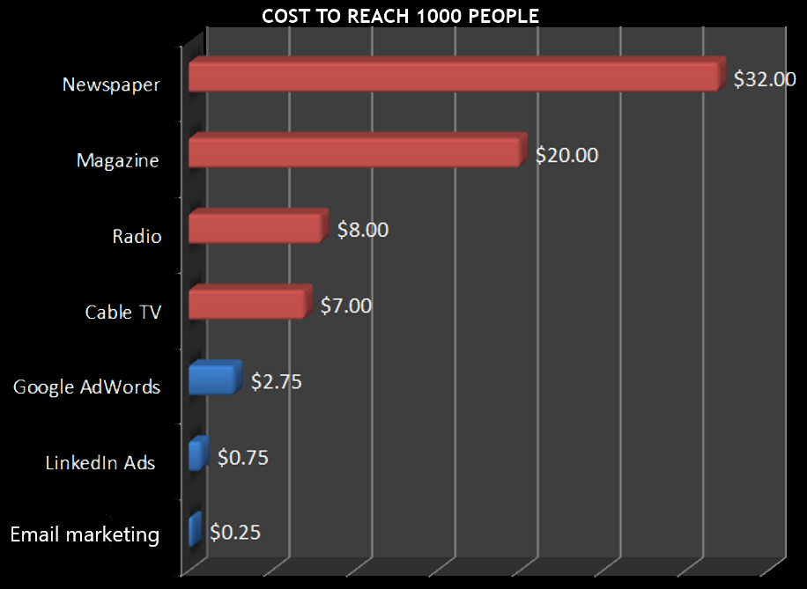
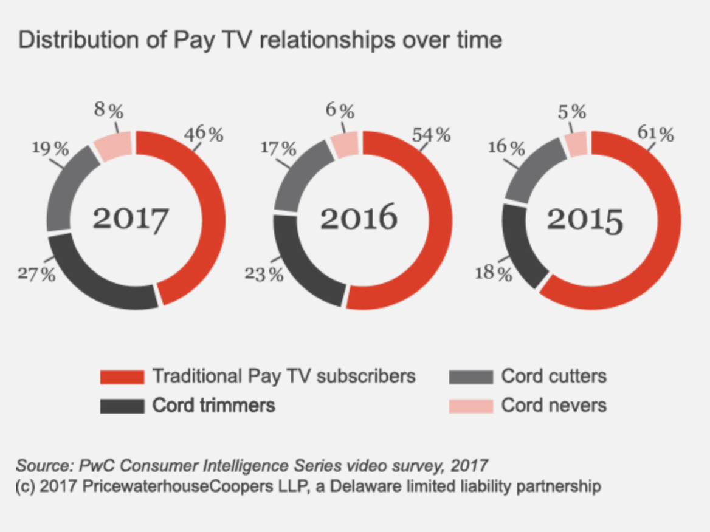
1. Introduction

Slide 10

1. Introduction
What?
Why?
How?

Slide 11
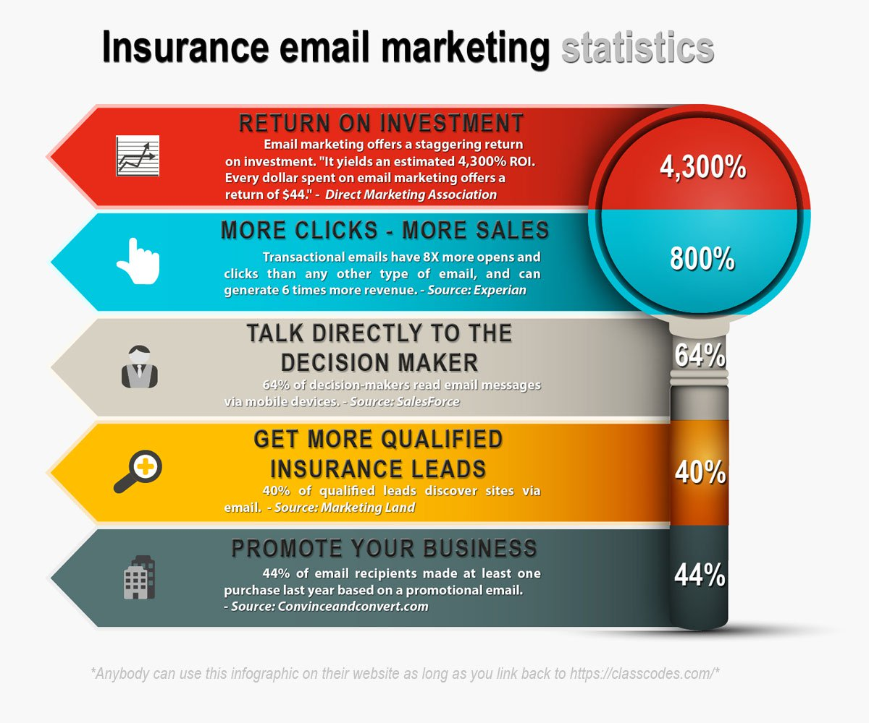
1. Introduction
What?
Why?
How?

Slide 12
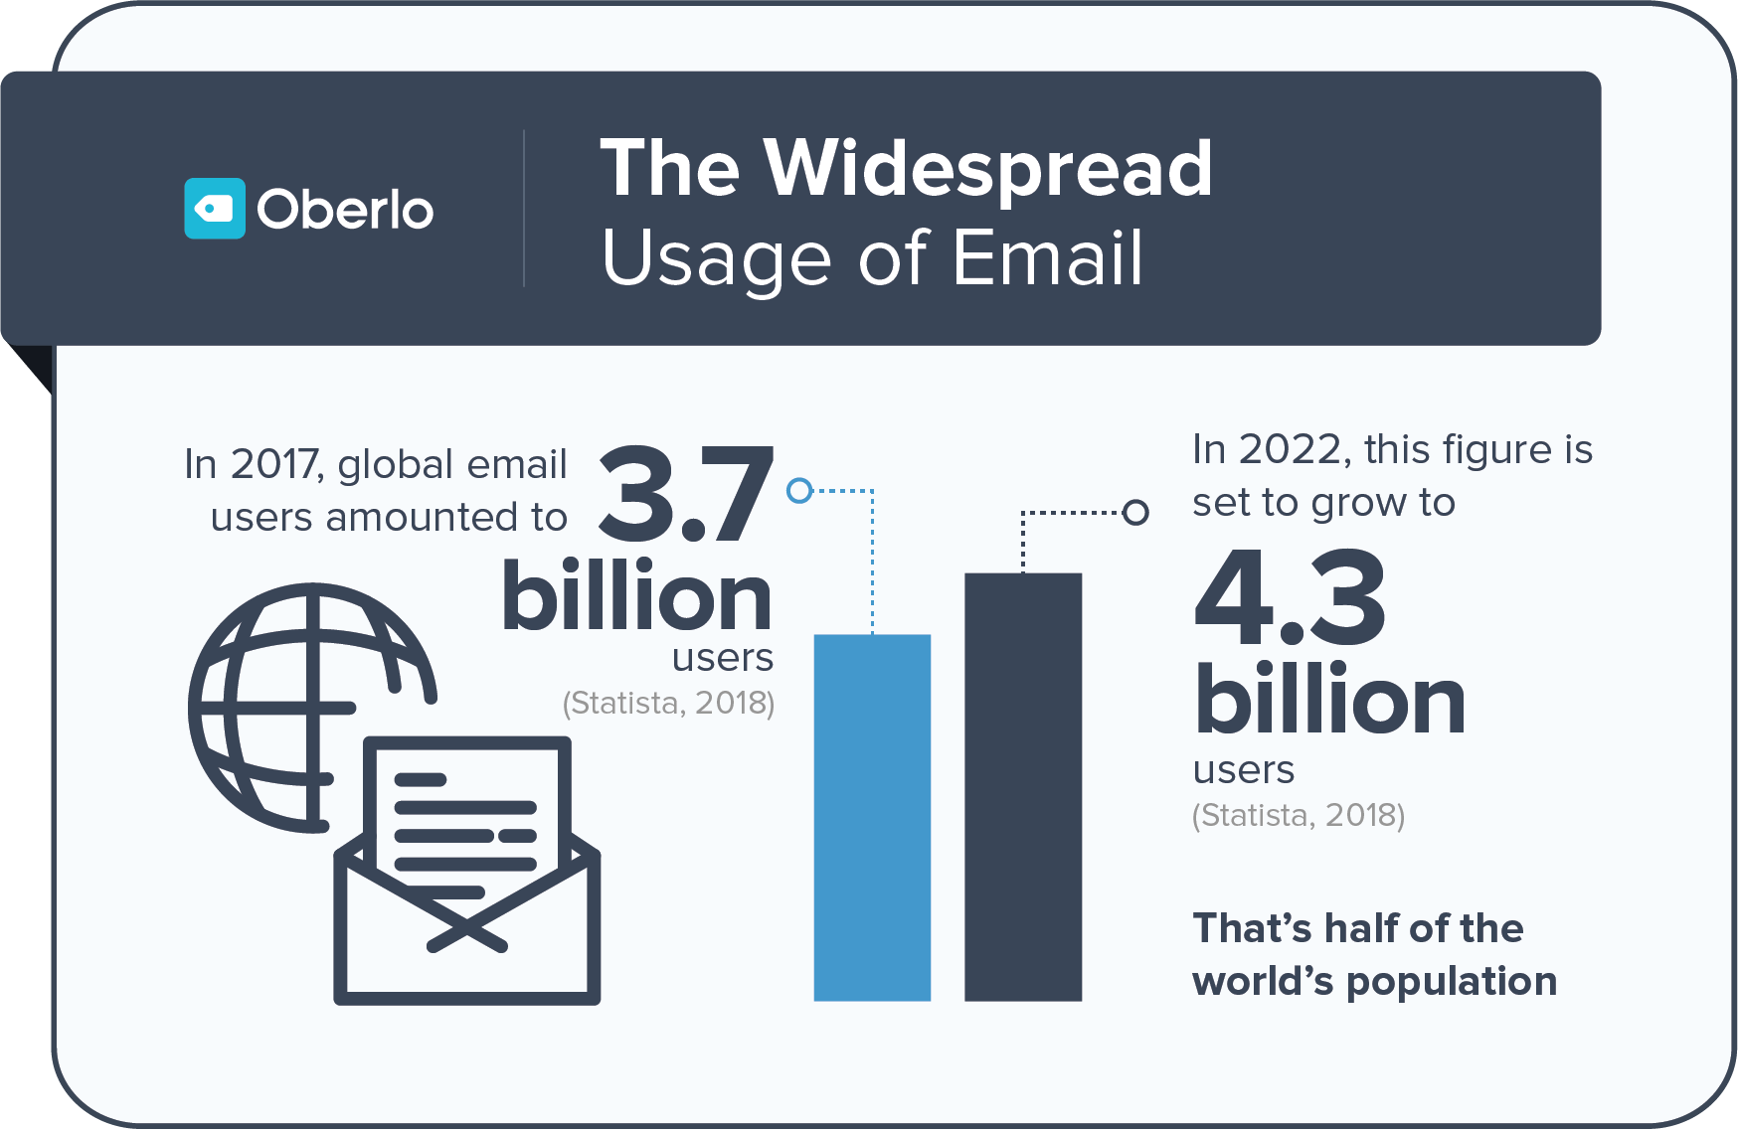
1. Introduction

Slide 13

Email marketing
Minimize the cost

Slide 14

Email marketing
High success rate

Slide 15

Email marketing
High speed and easy to use

Slide 16

Email marketing
Aim for the right target

Slide 17

Email marketing
Flexibility in design

Slide 18

Email marketing
Increase brand awareness and keep relationships with customers

Slide 19

2. Demo
20

Slide 20

2. Issues
Low Delivery Rate
Low Open Rate
Low Click Rate
High Spam Rate
Low Active Ratio
Limited Post-Click Activity
Limited statistics

Slide 21
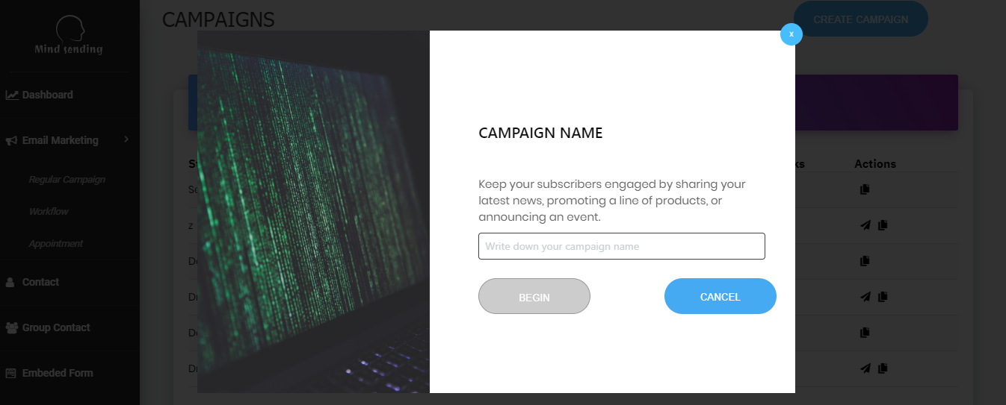
3. Idea & Solution
What?
Why?
How?

Slide 22
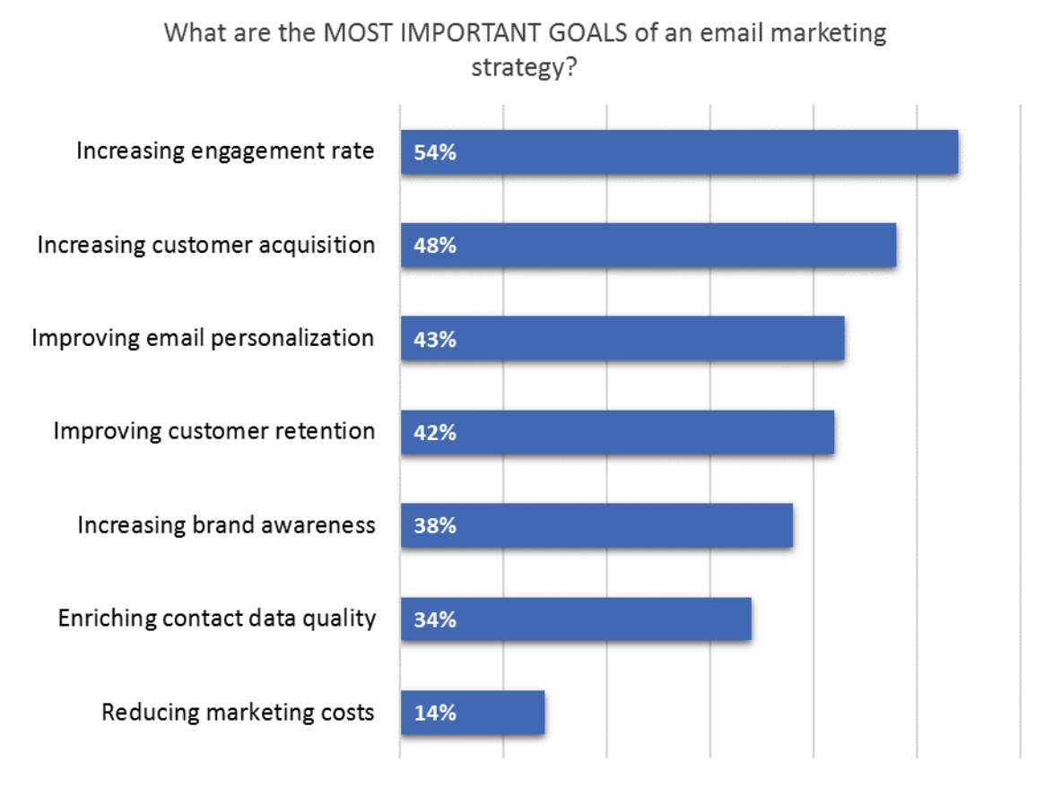
Idea & Solution

Slide 23
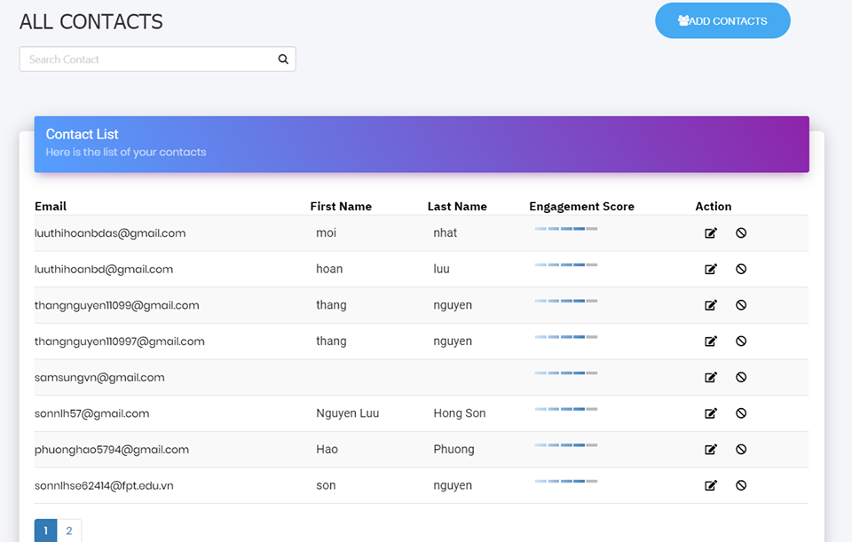
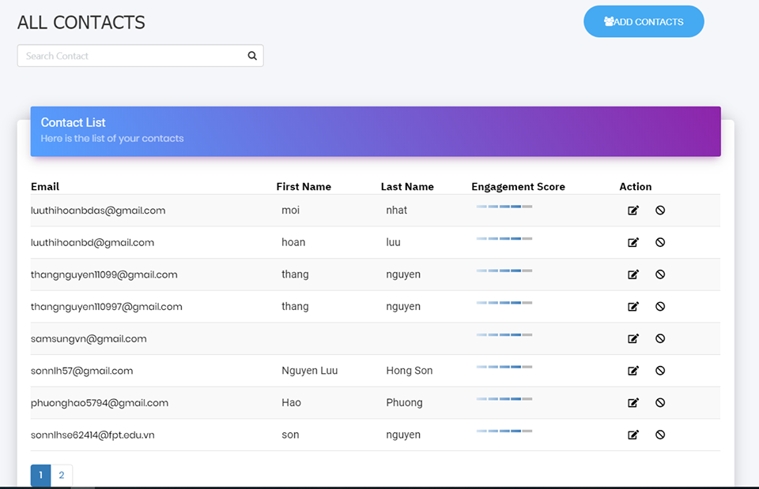
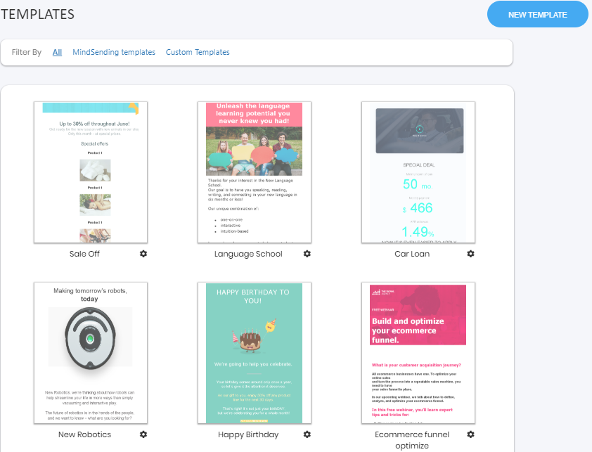
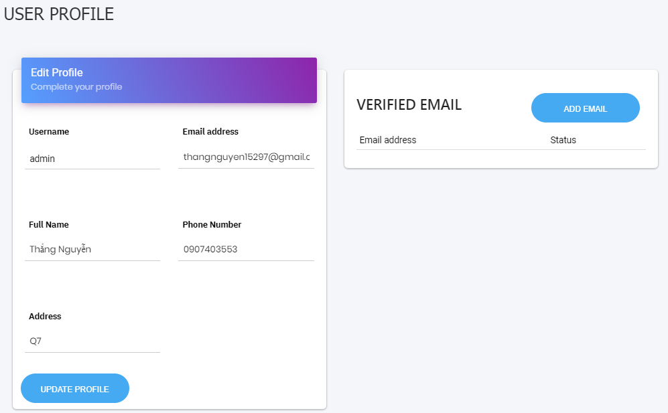





Contact
Add contact
Edit contact
View detail
Move to blacklist

Slide 24
Algorithm
$f\left(x\right)=a\left(x\right)+b$ $∀x ∈\{n\}$
a: total point after one day
d: point for current level of user

Slide 25
Algorithm
$f\left(x\right)=a\left(x\right)+b$ $∀x ∈\{n\}$
Open rate = $\frac{Total opens in one day}{Total emails that user receive}$
C$lick rate$= $\frac{\text{Total} \text{clicks} \text{in} \text{one} \text{day}}{Total emails that user receive}$
25

Slide 26
Algorithm
$f\left(x\right)=a(x)+b$ $∀x ∈\{n\}$
10%< Open rate < 25%
25%< Open rate < 75%
Open rate > 75%
+ 5 point
+ 10 point
+ 15 point
Open rate
10%< Click rate < 25%
25%< Click rate < 75%
Click rate > 75%
+ 10 point
+ 15 point
+ 20 point
Click rate

Slide 27
Algorithm
$f\left(x\right)=a(x)+b$ $∀x ∈\{n\}$
Opens > 3 in a row
+ 10 point
Opens
Clicks > 3 in a row
+ 20 point
Clicks

Slide 28
Algorithm
$f\left(x\right)=a(x)+b$ $∀x ∈\{n\}$
Delivery
Every mail is received
+ 2 point
Do not open email than 3 times
- 5 point
Opens

Slide 29
Algorithm
$f\left(x\right)=a(x)+b$ $∀x ∈\{n\}$
b = ( current level + 1 ) * ln( current level)
For example:
current level is 2
=> b = ( 2 +1 ) * ln(2)

Slide 30

Algorithm
Open rate
Click rate
Opens
Clicks
Opens
calculate
calculate
calculate
calculate
calculate
a(x)
Level 1 : 30 exp
Level 2: 65 exp
Level 3: 102 exp
Level 4: 247 exp
Level 5 : 534 exp
+ score
b = ( current level + 1 ) * ln( current level)
26

Slide 31
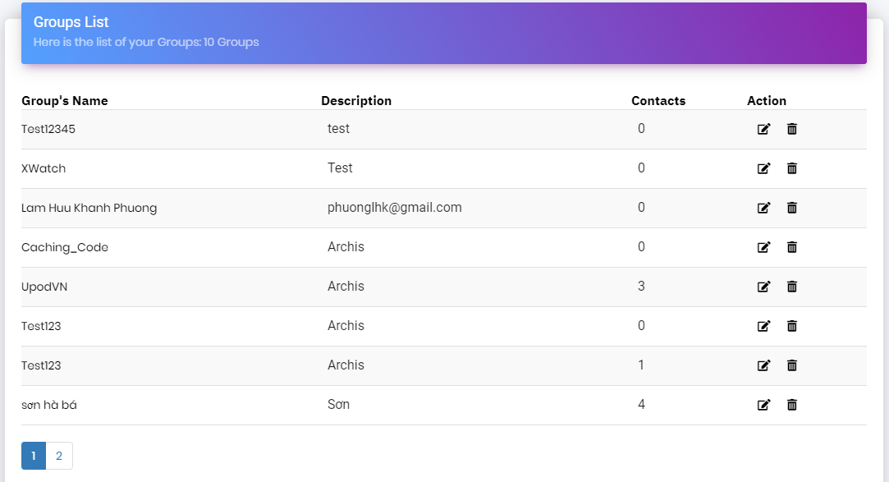
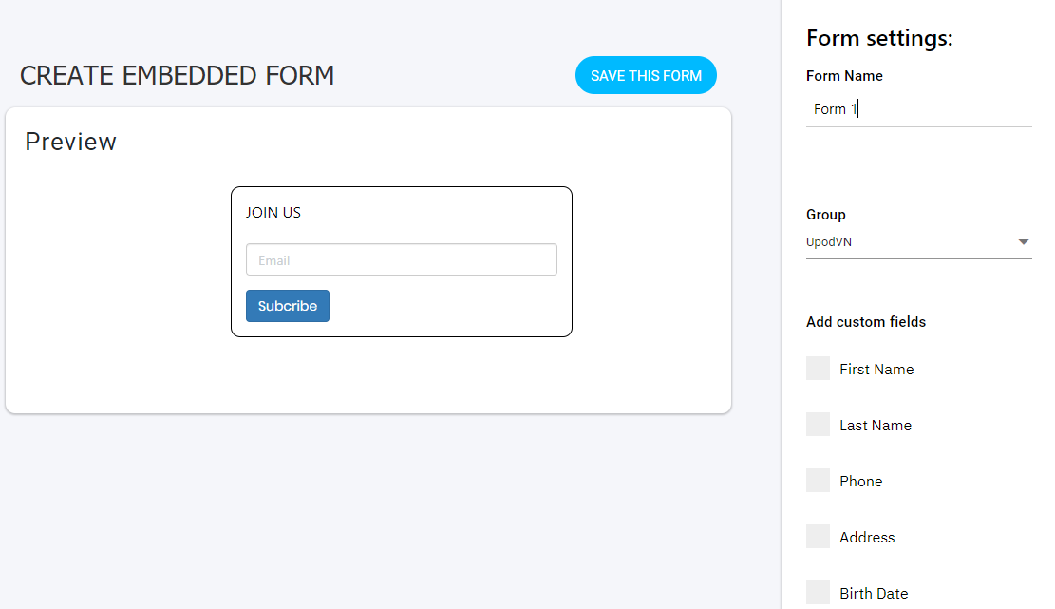
Group contact
Create group
Edit group
View detail
Create segment

Slide 32



User profile
Update profile
Add verify email

Slide 33
Template
Create template
Preview template
Edit template
Copy template

Slide 34
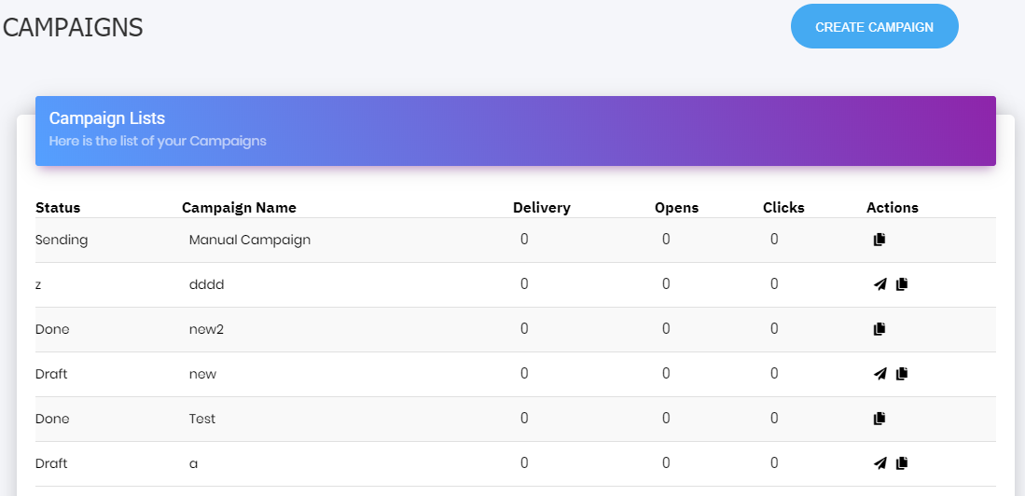
Regular campaign
Create campaign
Edit campaign
View detail
Copy campaign

Slide 35
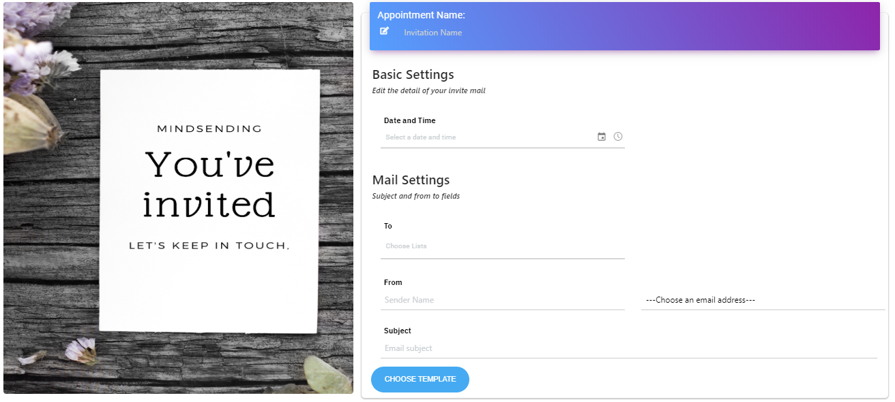
Appointment
Create appointment
Edit appointment
View detail

Slide 36
Embed form
Create form
Copy code
Preview form

Slide 37
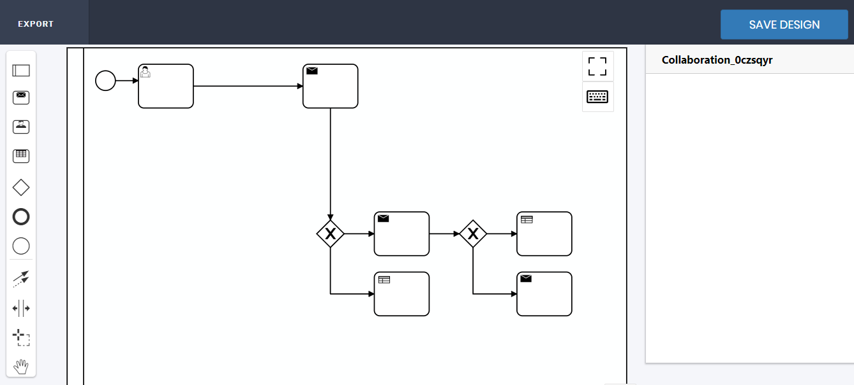
Workflow
Create workflow
View detail

Slide 38
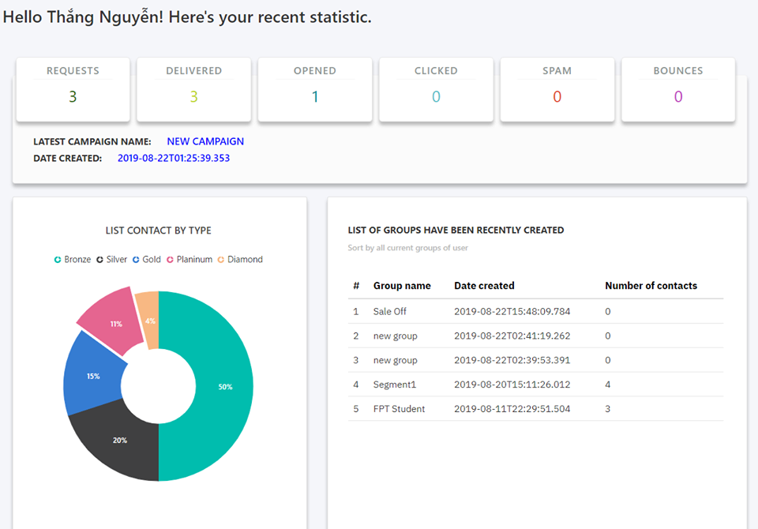
Dashboard
View detail

Slide 39

















4. Outcome

Slide 40













5. Future Plan

Slide 41




Thanks for listening!

Slide 42
Q & A

